Slide 1

FoodMeOnce

Slide 2


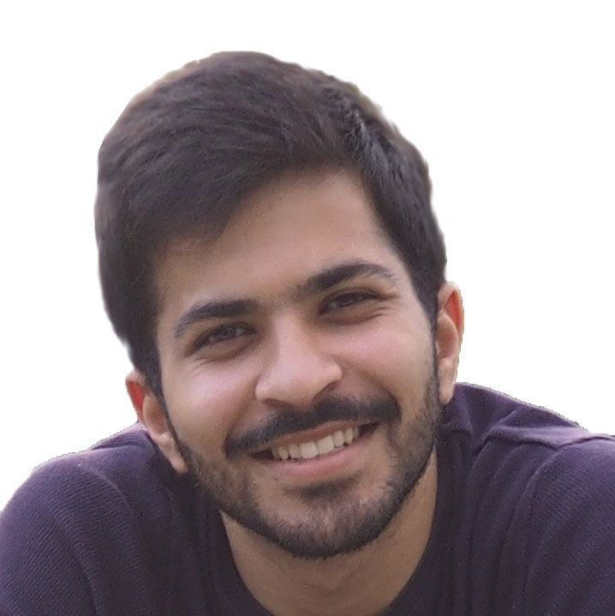
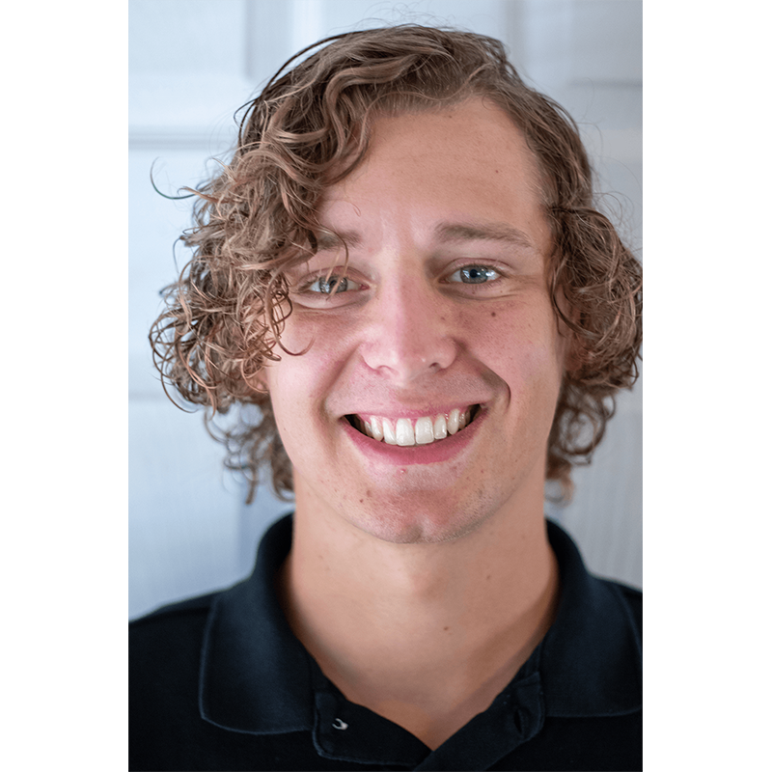
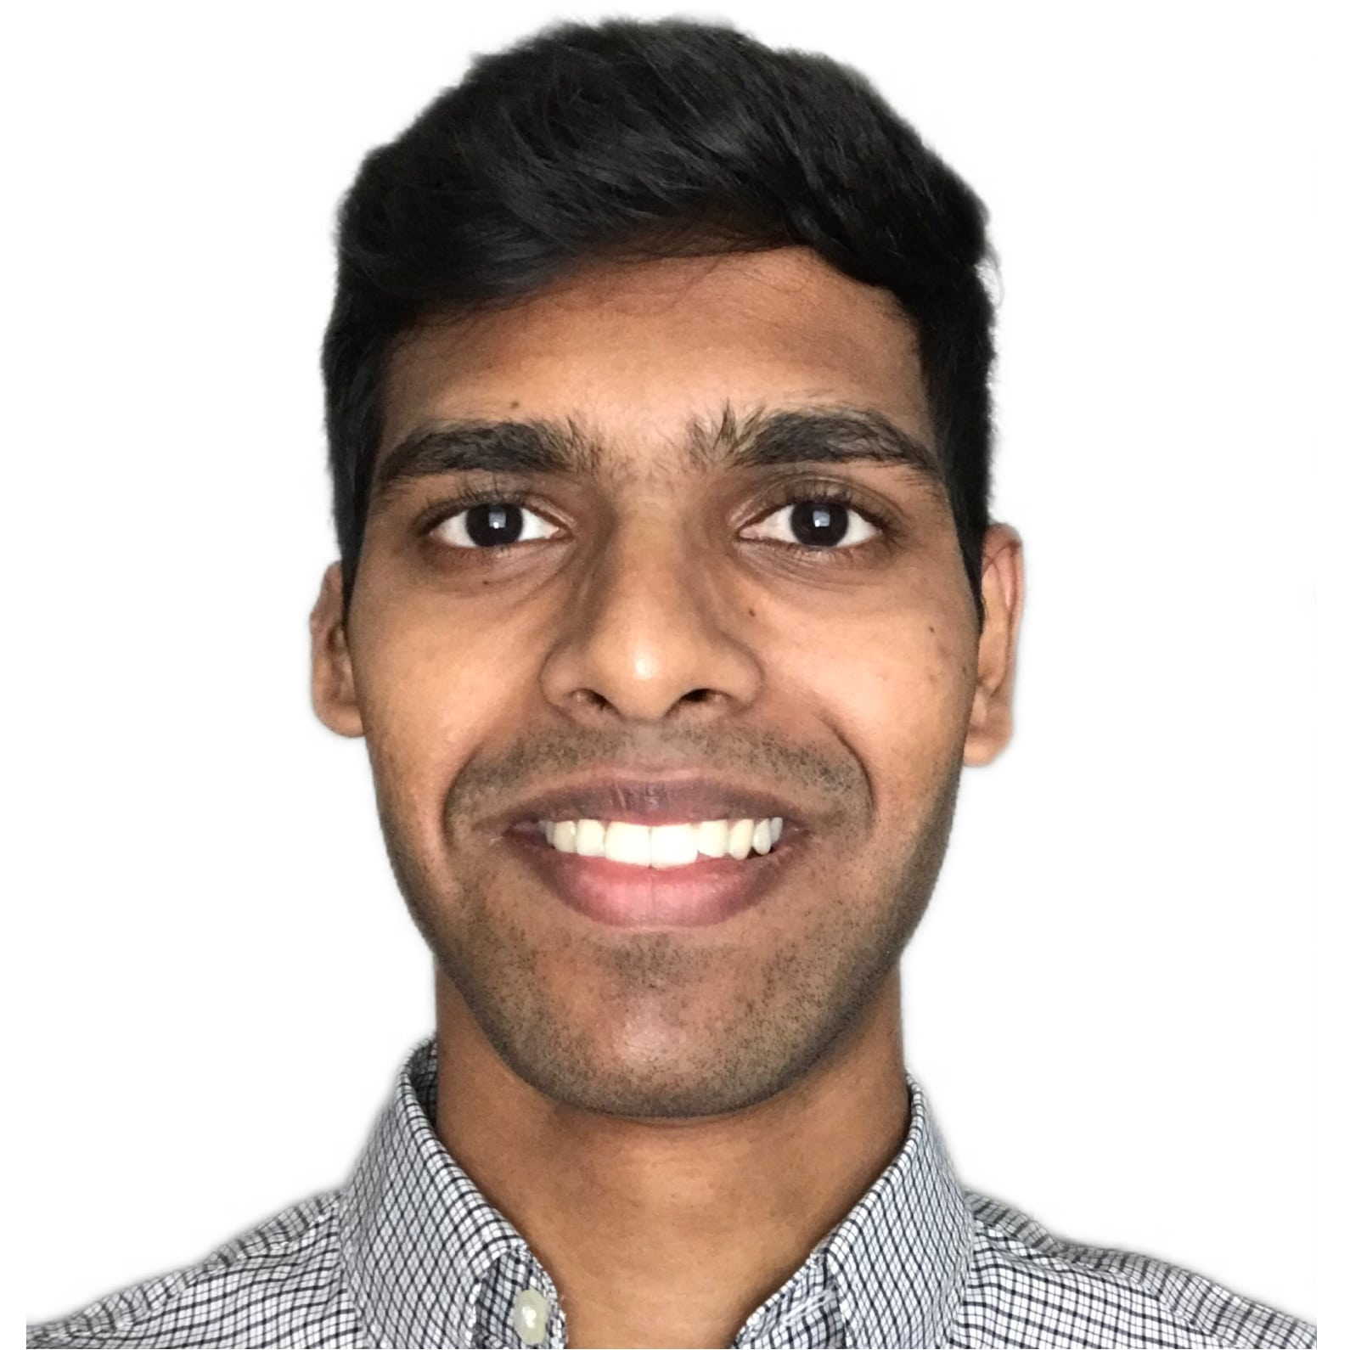
Meet the team!
Chris Chasteen Gyuwon Kim Shub Trivedi Brian Dyck Nithin Pingilli

Slide 3
What is FoodMeOnce?
Food Me Once is being developed to provide a platform for users to gather information on the food security of communities across the United States. It combines disparate data sources about food security across districts/counties, political representation and legislation to present a well-rounded perspective. It will enable users to understand how political representation affects health outcomes as well as what actions have been undertaken to ensure equitable access to healthy food and eradicating food deserts. The website will generate statistics/visualizations across various dimensions (population, representation, race, etc.).
Notes:
Chris

Slide 4
About the Site
4 sprints
Phase 1: Basic Static Website
Phase 2
Dynamic React Web Application
RESTful API
PostGres DB
Phase 3: Sorting, Searching, Filtering
Phase 4: Visualizations
Models
Districts
Representatives
Legislation
Links
FoodMeOnce GitLab Repository
FoodMeOnce API Documentation
Notes:
Chris

Slide 5
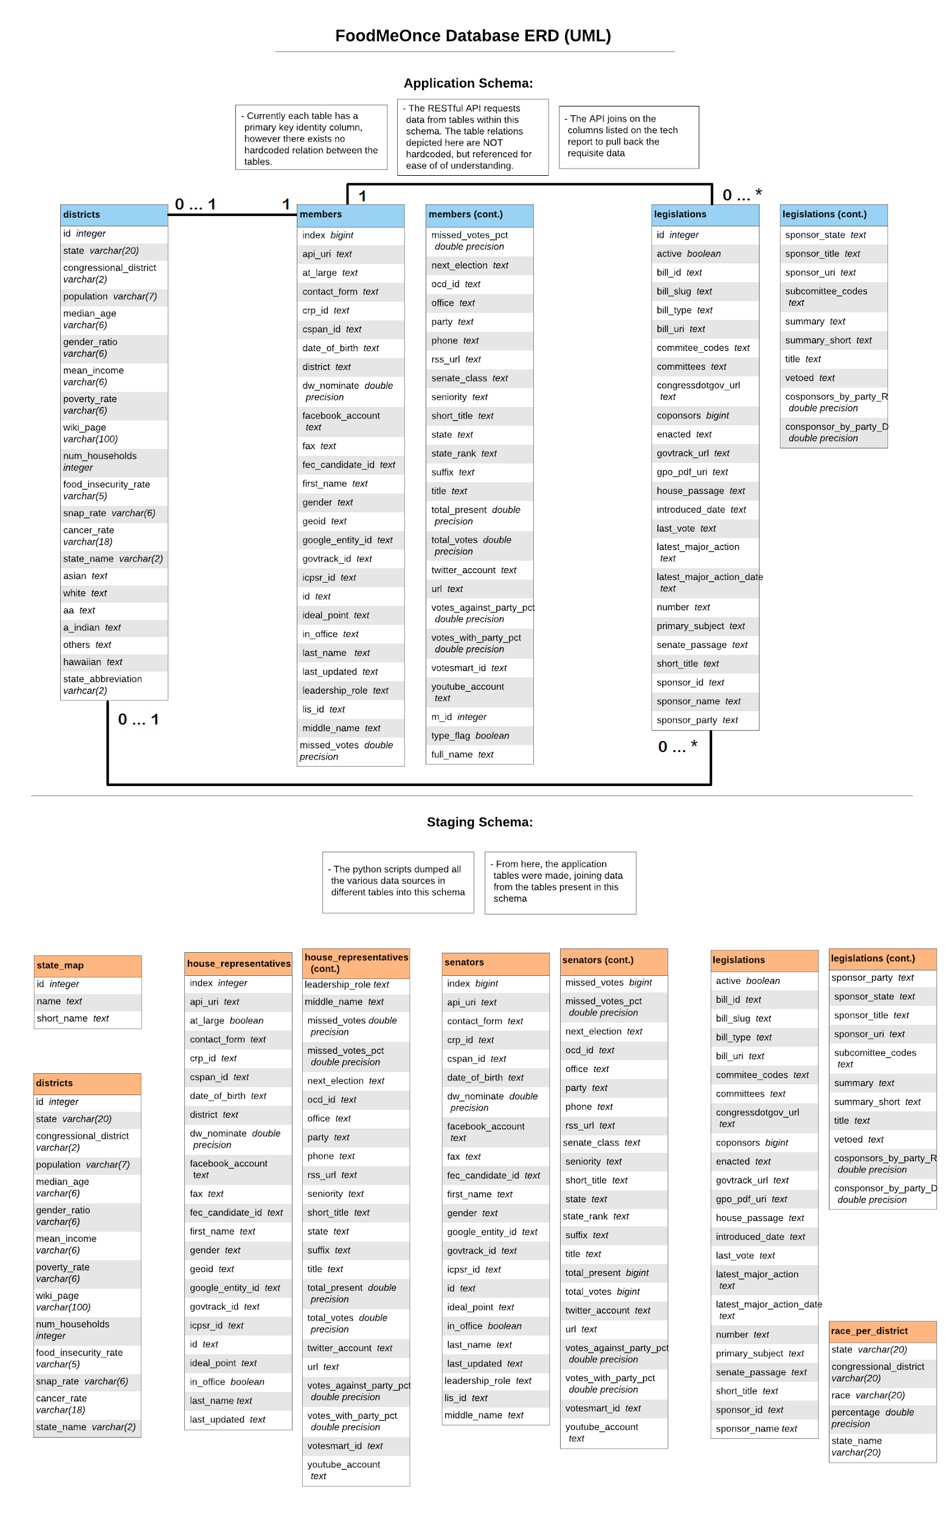
Database
Notes:
Shub

Slide 6
Tool stack
Front-end framework
React Javascript
Bootstrap and CSS
Selenium
Mocha
D3
Back-End Tools
PostgreSQL
POSTMAN
SQLAlchemy
Flask
Python
IDEs
Pycharm IDE
VSCode
Backend
Amazon S3
Domain
NameCheap
Route53
Others
Gitlab
LucidChart
Docker
Gitlab CI/CD
Notes:
Shub

Slide 7
Demonstration
Notes:
Shub - District Sorting, Filtering
Gyuwon - Rep searching
Brian - Site-wide search
Chris - 1st viz
Nithin - 2nd viz & 3rd viz

Slide 8
What did we do well?
Made website dynamic in phase 1
Searching, Sorting, Filtering
Getting each phase reviewed by the TAs
Well paced throughout each phase of the project.
Gitlab Issue Board
Communication with our Customer team
Notes:
Nithin
Shub

Slide 9
What did we learn?
E2E website building
Deploying and hosting in AWS
Designing an API
Domains and subdomains
Database design
React and Flask frameworks
Postman API documentation
Importance of code readability
Notes:
Gyuwon

Slide 10
What can we do better?
UI/UX
Relative spacing of elements on screen
Did not consider mobile usage
Prettier visuals
Code refactoring/maintainability
Could have used flask-restless
District model page - dynamic map load time
Notes:
Brian

Slide 11
What puzzled us?
How to get started
Asynchronous API requests
Searching with Flask
D3
Gitlab CI setup
Notes:
Chris

Slide 12

Developer Team - PutItInPark

Slide 13
What did they do well?
UI/UX is great
Communicating on user stories was very thorough
Made site mobile friendly
Notes:
Nithin

Slide 14
What did we learn from their website?
Hovering over instances feature
Using entire space for the instance page
Use of icons(search icon, loading icon)
Notes:
Nithin

Slide 15
What can they do better?
API subdomain
Meeting phase requirements
Model page search results sometimes do not contain search term
Notes:
Shub

Slide 16
What puzzles us?
How the model specific search works?
Notes:
Gyuwon

Slide 17
Conclusions
Notes:
All of us

Slide 18
Thank you!

